Slide 1
Security in computing

Slide 2

Aim of Course
our focus is on Security
which consists of measures to deter, prevent, detect, and correct security violations that involve the transmission & storage of information
Notes:
Detail the focus of this book/course, which is on Internet Security - being measures to deter, prevent, detect, and correct security violations that involve the transmission & storage of information.

Slide 3
Definitions
Computer Security - generic name for the collection of tools designed to protect data and to thwart hackers
Network Security - measures to protect data during their transmission
Internet Security - measures to protect data during their transmission over a collection of interconnected networks
Notes:
Here are some key definitions, note boundaries between them are blurred.

Slide 4
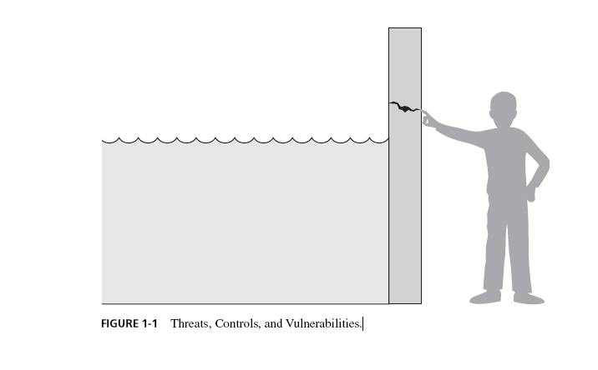

Slide 5
Attacks
Vulnerability – a weakness in the security system that could be exploited to cause harm or loss.
Threat – a set of circumstances that has the potential to cause loss or harm.

Slide 6
Attack – human who exploits a vulnerability
Control – a protective measure against an attack

Slide 7
Aspects of System (and information) security
Security attack – any action that compromises the security of system and information.
Security mechanism – to detect, prevent, or recover from a security attack.
Security service – service that enhances and counters security attacks.
Notes:
In the context of computer or network security, you need to understand and distinguish three terms:
Attacks, mechanisms (methods or algorithms) and services which may use the mechanisms that are devised.
The mechanism will depend upon the kind of protection that you want to provide against a particular attack while service not only implements the mechanism, but also can provide bolt on to improve the security.
Usually the attacks are not well defined, once type of attack is known, mechanisms are devised and they are incorporated into the service. For example computer virus.

Slide 8
Aspects of System (and information) security
Security attack
Security Mechanisms
Security service
Notes:
In the context of computer or network security, you need to understand and distinguish three terms:
Attacks, mechanisms (methods or algorithms) and services which may use the mechanisms that are devised.
The mechanism will depend upon the kind of protection that you want to provide against a particular attack while service not only implements the mechanism, but also can provide bolt on to improve the security.
Usually the attacks are not well defined, once type of attack is known, mechanisms are devised and they are incorporated into the service. For example computer virus.

Slide 9



A Security Example: Alice, Bob, Trudy
Alice and Bob want to communicate “securely”.
Alice
Bob
channel
data, control messages
data
sender
receiver
data
Trudy

Slide 10

Passive Attacks
Notes:
Have “passive attacks” which attempt to learn or make use of information from the system but does not affect system resources.
By eavesdropping on, or monitoring of, transmissions to:
+ obtain message contents (as shown above in Stallings Figure 1.3a), or
+ monitor traffic flows
Are difficult to detect because they do not involve any alteration of the data.

Slide 11

Active Attacks
Notes:
Also have “active attacks” which attempt to alter system resources or affect their operation.
By modification of data stream to:
+ masquerade of one entity as some other
+ replay previous messages (as shown above in Stallings Figure 1.4b)
+ modify messages in transit
+ denial of service
Active attacks present the opposite characteristics of passive attacks. Whereas passive attacks are difficult to detect, measures are available to prevent their success. On the other hand, it is quite difficult to prevent active attacks absolutely, because of the wide variety of potential physical,software,and network vulnerabilities. Instead, the goal is to detect active attacks and to recover from any disruption or delays caused by them.

Slide 12
Attacks – Passive types
Passive (interception) – eavesdropping on, monitoring of, transmissions.
The goal is to obtain information that is being transmitted.
Notes:
It is also classify the attacks on the property that the attack compromises, the attacks can be classified as passive or active depending on the damage that the attack does.

Slide 13
Attacks – Active types
Involve modification of the data stream or creation of a false stream

Slide 14
Security Attacks - Taxonomy
Source and Destination - can be
what is supposed to be and
what you get
Information
Source
Information
Destination
Normal
Information
Source
Information
Destination
Information
Source
Information
Destination
Interruption
Interception
Information
Source
Information
Destination
Information
Source
Information
Destination
Modification
Fabrication
Notes:
Pictorially the above taxonomy can be depicted as in the slide.

Slide 15
Interruption
Also known as denial of services.
Information resources (hardware, software and data) are deliberately made unavailable, lost or unusable, usually through malicious destruction.
Information source
Destination Source
Notes:
the employee’s account. The employee is able to intercept the message and delay it long enough to make a final access to the server to retrieve sensitive information, then the message is forwarded, the action is taken and the confirmation is posted. The employee’s action may go unnoticed for some considerable amount of time.
5. A message is sent from a customer to a stock broker to buy a particular stock. Subsequently the stock lose in value and the customer denies sending the message.

Slide 16
Interception
Also known as un-authorised access.
Difficult to trace as no traces of intrusion might be left.
Information source
Destination Source
Notes:
This is an attack on the confidentiality.

Slide 17
Modification
Also known as tampering a resource.
Resources can be data, programs, hardware devices, etc.
Information source
Destination Source
Notes:
An unauthorsied party not only gains access to but tampers with the resource. This attack is on integrity of data/information.
Examples include changing values in a data file, altering a program so that it performs differently, and modifying the content of messages being transmitted in a network.

Slide 18
Fabrication
Also known as counterfeiting (of objects such as data, programs, devices, etc).
impersonation/masquerading
Information source
Destination Source
Notes:
The unauthorsed party inserts counterfeit objects into the system. This is an attack on authenticity.

Slide 19
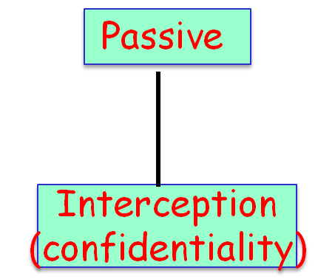
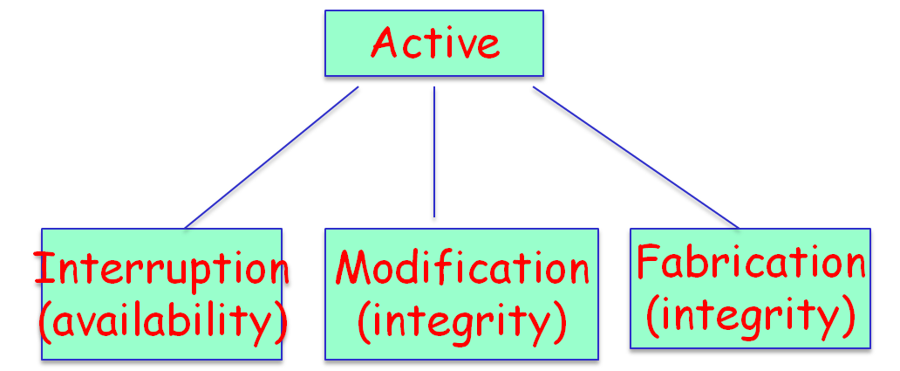
Attacks

Slide 20
Aspects of System (and information) security
Security attack
Security service
Security Mechanisms
Notes:
In the context of computer or network security, you need to understand and distinguish three terms:
Attacks, mechanisms (methods or algorithms) and services which may use the mechanisms that are devised.
The mechanism will depend upon the kind of protection that you want to provide against a particular attack while service not only implements the mechanism, but also can provide bolt on to improve the security.
Usually the attacks are not well defined, once type of attack is known, mechanisms are devised and they are incorporated into the service. For example computer virus.

Slide 21
Security Services
Confidentiality
  only sender, intended receiver should “understand” message contents
  Authentication
  Concerned with assuring that a communication is authentic.
  sender, receiver want to confirm identity of each other

Slide 22
Security Service
Integrity
  Assures that messages are received as sent, with no duplication, insertion, modification, reordering, or replays.
Nonrepudiation
  Prevents either sender or receiver from denying a transmitted message

Slide 23
Security Services
Access and Availability
  services must be accessible and available to properly authorized users

Slide 24
Security Attacks
Interruption: This is an attack on availability
Interception: This is an attack on confidentiality
Modification: This is an attack on integrity
Fabrication: This is an attack on authenticity

Slide 25
Aspects of System (and information) security
Security attack
Security service
Security Mechanisms
Notes:
In the context of computer or network security, you need to understand and distinguish three terms:
Attacks, mechanisms (methods or algorithms) and services which may use the mechanisms that are devised.
The mechanism will depend upon the kind of protection that you want to provide against a particular attack while service not only implements the mechanism, but also can provide bolt on to improve the security.
Usually the attacks are not well defined, once type of attack is known, mechanisms are devised and they are incorporated into the service. For example computer virus.

Slide 26
Security Mechanisms
A mechanism that designed to detect, prevent, or recover from a security attack.
  No single mechanism that will provide all the security services.

Slide 27
Security Goals
Confidentiality
Integrity
Avalaibility

Slide 28
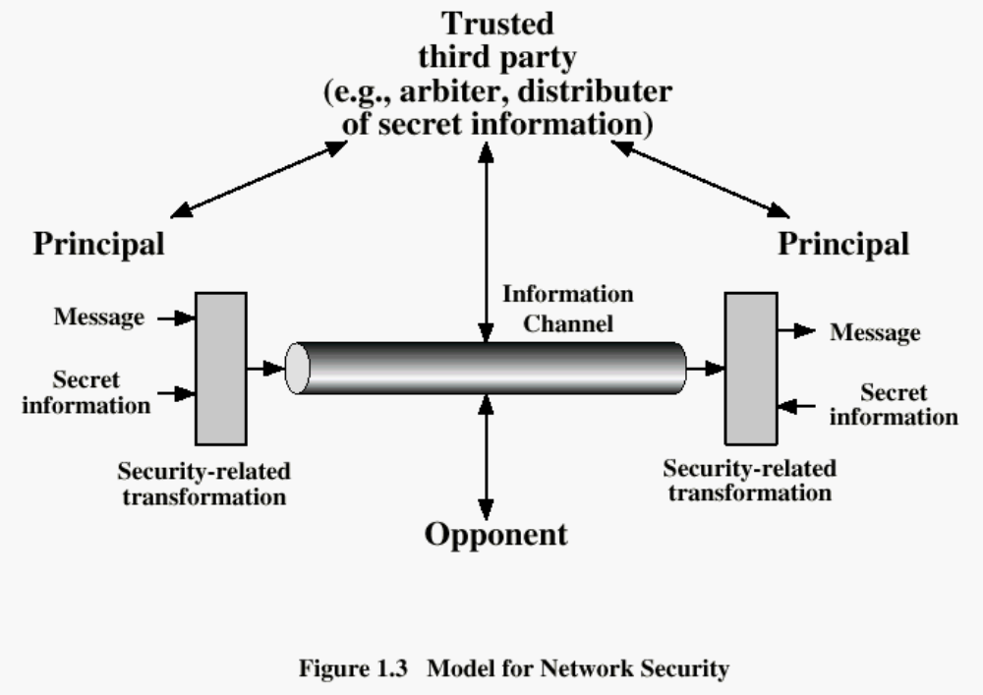

Slide 29
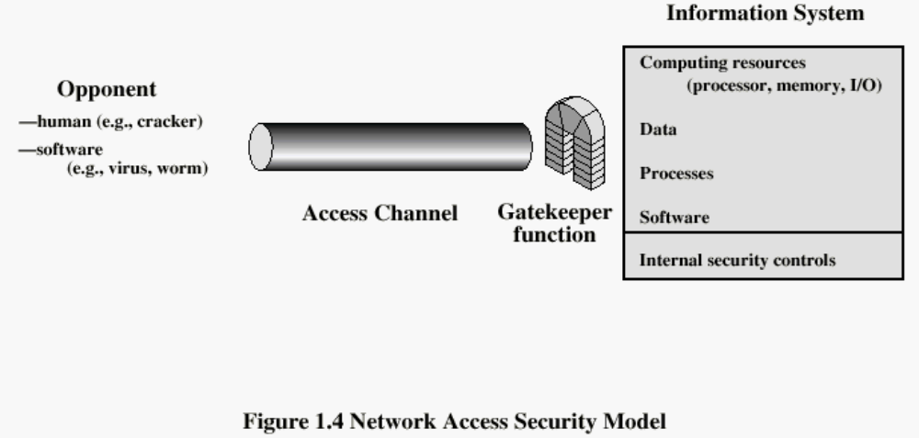

Slide 30
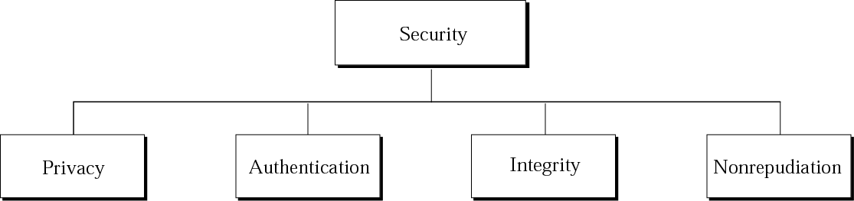
Aspects of security
Privacy : only the sender and the receiver of the message are able to understand the contents of the messages.
Authentication : the receiver needs to be sure of the sender’s identity.
Integrity : the contents of the message should not be changed during transmission.
Non-repudiation : a secure system needs to prove that the sender actually sent the message.

Slide 31
Privacy
The privacy can be achieved using encryption / decryption methods.

Slide 32
Cryptography- art of hiding information
is the art of achieving security by encoding messages to make them unreadable
Cryptography is the science of using mathematics to encrypt and decrypt data.

Slide 33
Cryptography
kryptos (hidden) + graphein (to write) = secret writing
It form the basis to many security communication concerns

Slide 34
Story...
The story begins when Julius Caeser send messages to his trusted acquaintances, he didn't trust the messengers.So he replaced every 'A' with 'D' and 'B' with 'E' and so on through the alphabets.
Only someone who knew 'SHIFT BY 3' could decipher his message.
For example, if the original message was,
‘GIVE TWO MILLION’!
Message after replacement would be....
'JLYHWZRPLOORQ'!

Slide 35
Terminologies
Plain Text
The original message is called as plain text or in other words plain text is a message that can be understood by the sender, recipient and anyone else who gets access to that message. Eg: ‘GIVE TWO MILLION’!
Cipher Text
The disguised message is called as the cipher text or When a plain text message is coded using any suitable scheme the resulting message is called as cipher text.
'JLYHWZRPLOORQ'!

Slide 36
Terminologies...
Encryption
The method of producing cipher text from plaintext using the key is called as encryption or enciphering or encoding
‘GIVE TWO MILLION’!
={Shift by 3}
'JLYHWZRPLOORQ'!
Encipher: Transform data into unreadable format
.

Slide 37
Decryption Restoring the plaintext from cipher text using the key is called as decryption or deciphering or decoding
      'JLYHWZRPLOORQ'!
      ={Shift by 3}
‘GIVE TWO MILLION’!
Decipher: Transform data into readable format
Key: Encryption and decryption usually make use of a key, and the coding method is such that decryption can be performed only by knowing the proper key.

Slide 38

Encryption / Decryption
A
B
plaintext
plaintext
encryption
encrypted transmission
ciphertext
decryption

Slide 39
Terminology
Cryptanalysis: The study of encryption and encrypted messages, with the goal of finding the hidden meanings of the messages.
The art of breaking ciphers, i.e. retrieving the plaintext without knowing the proper key. (cryptanalyst)
Cryptology = cryptography + cryptanalysis
A cryptosystem is a system for encryption and decryption.

Slide 40
Terminology
Cryptographers: People who do cryptography
Cryptanalysts: practitioners of cryptanalysis

Slide 41
Conventional Cryptosystem Principles
cryptosystem has the following five ingredients:
  Plaintext
  Encryption algorithm
  Secret Key
  Ciphertext
  Decryption algorithm
Security depends on the secrecy of the key, not the secrecy of the algorithm

Slide 42


Slide 43
Notations
P: plaintext
C: ciphertext
E: encryption
D: decryption
C = E (P)
P = D (C)

Slide 44
Ciphertext C=E_{K}(P)
Encryption
Process E
Decryption
Process D
Plaintext Message (P )
Plaintext Message (P)
P=D(C)
Encryption
Key (K)
Decryption
Key (K')

Slide 45

Classifications
Classification of cryptosystems
  Symmetric cryptosystems
  Asymmetric cryptosystems

Slide 46
Symmetric cryptosystems
The same key is used for both encryption and decryption purposes

Slide 47

Plain-text input
Cipher-text
Plain-text output
“The quick brown fox jumps over the lazy dog”
“The quick brown fox jumps over the lazy dog”
“AxCv;5bmEseTfid3)fGsmWe#4^,sdgfMwir3:dkJeTsY8R\s@!q3%”
Encryption
Decryption
Same key
(shared secret)

Slide 48
Key Distribution
A key could be selected by A and physically delivered to B.
A third party could select the key and physically deliver it to A and B.

Slide 49

Assymmetric Cryptosystem
Different keys are used for encryption and decryption purposes.
The pair of keys are mathematically related and consist of a public key that can be published without doing harm to the system's security and a private key that is kept secret.
Also known as public key cryptosystems

Slide 50

Public Key Encryption
Clear-text Input
Cipher-text
Clear-text Output
“The quick brown fox jumps over the lazy dog”
“The quick brown fox jumps over the lazy dog”
“Py75c%bn&*)9|fDe^bDFaq#xzjFr@g5=&nmdFg$5knvMd’rkvegMs”
Encryption
Decryption
public
Different keys
private
Recipient’s public key
Recipient’s private key

Slide 51
Assymmetric Cryptosystem
The public key is used for encryption purposes and lies in the public domain.
Anybody can use the public key to send an encrypted message.
The private key is used for decryption purposes and remains secret.
An example of a public cryptosystem is the RSA cryptosystem.

Slide 52
Public Key Pros and Cons
Strength
  Solves problem of passing the key
  Allows establishment of trust between parties
  relatively long life time of the key

Slide 53
Cipher Classification
Ciphers
Public Key
Symmetric
Key
PublicKey
Signature
ID
Classical
Stream
Block
Transposition
Substitution

Slide 54
Classical Ciphers
Substitution ciphers
  Letters of the plaintext messages are replaced with other letters during the encryption
Transposition ciphers
  The order of plaintext letters is rearranged during encryption

Slide 55
Classical Substitution Ciphers
A substitution cipher replaces one symbol with another.
if plaintext is viewed as a sequence of bits, then substitution involves replacing plaintext bit patterns with ciphertext bit patterns
Notes:
In this section and the next, we examine a sampling of what might be called classical encryption techniques. A study of these techniques enables us to illustrate the basic approaches to symmetric encryption used today and the types of cryptanalytic attacks that must be anticipated. The two basic building blocks of all encryption technique are substitution and transposition. We examine these in the next two sections. Finally, we discuss a system that combine both substitution and transposition.

Slide 56
Substitution Ciphers
Monoalphabetic cipher
  Caesar cipher
Polyalphabetic cipher
  Vigenère cipher
Multiple letter cipher
  Playfair cipher

Slide 57
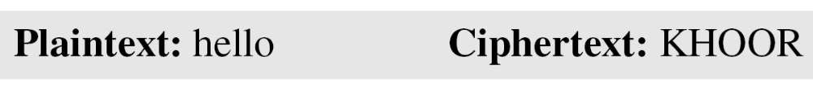
Monoalphabetic Ciphers
In monoalphabetic substitution, the relationship between a symbol in the plaintext to a symbol in the ciphertext is always one-to-one.
The following shows a plaintext and its corresponding ciphertext. The cipher is probably monoalphabetic because both l’s are encrypted as O’s.

Slide 58
Polyalphabetic Ciphers
In polyalphabetic substitution, each occurrence of a character may have a different substitute. The relationship between a character in the plaintext to a character in the ciphertext is one-to-many.

Slide 59
Caesar Cipher
earliest known substitution cipher
by Julius Caesar
first attested use in military affairs
replaces each letter by 3rd letter on
example:
  meet me after the toga party
  PHHW PH DIWHU WKH WRJD SDUWB
Notes:
Substitution ciphers form the first of the fundamental building blocks. The core idea is to replace one basic unit (letter/byte) with another. Whilst the early Greeks described several substitution ciphers, the first attested use in military affairs of one was by Julius Caesar, described by him in Gallic Wars (cf. Kahn pp83-84). Still call any cipher using a simple letter shift a caesar cipher, not just those with shift 3.

Slide 60
Caesar Ciphers
A substitution cipher is one in which each character in the plaintext is substituted for another character in the ciphertext
The Caesar Cipher replaces each plaintext character by the character k positions to the right. In this example, k=3.
plaintext
A
B
C
D
E
F
D
E
F
G
H
I
J
K
L
M
N
O
P
Q
R
S
T
U
V
W
X
Y
Z
ciphertext
D
E
F
H
I
J
K
N
O
P
Q
R
T
U
V
W
X
W
Z
A
B
C
G
L
M
S

Slide 61
Example Operation
plaintext
A
B
C
D
E
F
G
H
I
J
K
L
M
N
O
P
Q
R
S
T
U
V
W
X
Y
Z
ciphertext
D
E
F
G
H
I
J
K
L
M
N
O
P
Q
R
S
T
U
V
W
X
Y
Z
A
B
C
MESSAGE
the word privacy does not appear in the indian constitution
w
k
h
zrug sulydfb grhv qrw dsshdu lq wkh lqgldq frqvwlwxwlrq
NOTE: the shift could be any value from 1 to 25

Slide 62
Caesar Cipher
can define transformation as:
  a b c d e f g h i j k l m n o p q r s t u v w x y z
  D E F G H I J K L M N O P Q R S T U V W X Y Z A B C
mathematically give each letter a number
  a b c d e f g h i j k l m n o p q r s t u v w x y z
  0 1 2 3 4 5 6 7 8 9 10 11 12 13 14 15 16 17 18 19 20 21 22 23 24 25
then have Caesar cipher as:
  c = E(p) = (p + k) mod (26)
  p = D(c) = (c – k) mod (26)
Notes:
This mathematical description uses modulo (clock) arithmetic. Here, when you reach Z you go back to A and start again. Mod 26 implies that when you reach 26, you use 0 instead (ie the letter after Z, or 25 + 1 goes to A or 0).
Example: howdy (7,14,22,3,24) encrypted using key f (ie a shift of 5) is MTBID

Slide 63
Cryptanalysis of Caesar Cipher
only have 26 possible ciphers
  A maps to A,B,..Z
could simply try each in turn
a brute force search
given ciphertext, just try all shifts of letters
do need to recognize when have plaintext
eg. break ciphertext "GCUA VQ DTGCM"
easy to break
:L FDPH L VDZ L FRQTXHUHG
I CAME I SAW I CONQUERED
Notes:
With a caesar cipher, there are only 26 possible keys, of which only 25 are of any use, since mapping A to A etc doesn't really obscure the message! Note this basic rule of cryptanalysis "check to ensure the cipher operator hasn't goofed and sent a plaintext message by mistake"!
Can try each of the keys (shifts) in turn, until can recognise the original message. See Stallings Fig 2.3 for example of search.
Note: as mentioned before, do need to be able to recognise when have an original message (ie is it English or whatever). Usually easy for humans, hard for computers. Though if using say compressed data could be much harder.
Example "GCUA VQ DTGCM" when broken gives "easy to break", with a shift of 2 (key C).

Slide 64
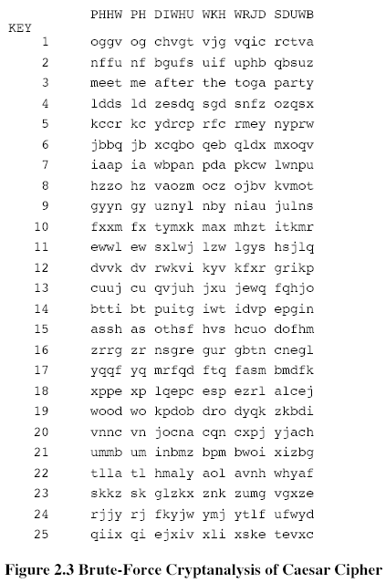

Slide 65
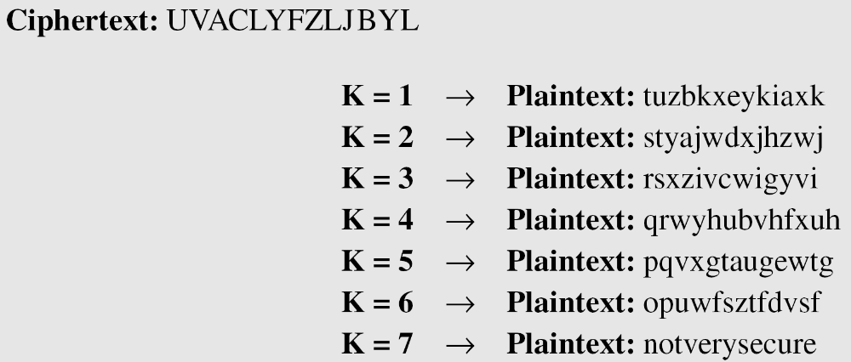
Example
Eve has intercepted the ciphertext “UVACLYFZLJBYL”. Show how she can use a brute-force attack to break the cipher.

Slide 66
Monoalphabetic Cipher
rather than just shifting the alphabet
could shuffle (jumble) the letters arbitrarily
each plaintext letter maps to a different random ciphertext letter
hence key is 26 letters long
  Plain: abcdefghijklmnopqrstuvwxyz
  Cipher: DKVQFIBJWPESCXHTMYAUOLRGZN
  Plaintext: ifwewishtoreplaceletters
  Ciphertext: WIRFRWAJUHYFTSDVFSFUUFYA
Disadvantage- key is too complicated to be remembered
Notes:
With only 25 possible keys, the Caesar cipher is far from secure. A dramatic increase in the key space can be achieved by allowing an arbitrary substitution, where the translation alphabet can be any permutation of the 26 alphabetic characters.
See example translation alphabet, and an encrypted message using it.

Slide 67
Keyword Cipher
There will be many keys but still easy to remember
Keyword cipher:
1. select a keyword - if any letters are repeated, drop the second
and all other occurrences from the keyword
2. write the keyword below the alphabet, fill in the rest of the
space with the remaining letters in the alphabet in their
standard order

Slide 68
Example
The keyword is COUNT
plaintext
A
B
C
D
E
F
G
H
I
J
K
L
M
N
O
P
Q
R
S
T
U
V
W
X
Y
Z
ciphertext
C
O
U
N
T
A
B
D
E
F
G
H
I
J
K
L
M
P
Q
R
S
V
W
X
Y
Z
So a goes to c, b goes to o, . . .

Slide 69
Starting Position
The keyword does not have to start at the beginning of the plaintext alphabet
  it could start at any letter
  for example, “count” could start at “k”
plaintext
A
B
C
D
E
F
G
H
I
J
K
L
M
N
O
P
Q
R
S
T
U
V
W
X
Y
Z
ciphertext
M
P
Q
R
S
V
W
X
Y
Z
C
O
U
N
T
A
B
D
E
F
G
H
I
J
K
L

Slide 70
Example
If the keyword is “visit” (note, the second “i” in visit is dropped below) starting at “a” and the plaintext is “next”, the ciphertext is:
N E X T
plaintext
A
B
C
D
E
F
G
H
I
J
K
L
M
N
O
P
Q
R
S
T
U
V
W
X
Y
Z
ciphertext
V
I
S
T
A
B
C
D
E
F
G
H
J
K
L
M
N
O
P
Q
R
U
W
X
Y
Z
K
A
X
Q

Slide 71
Monoalphabetic Cipher
  Key sentence: THE MESSAGE WAS TRANSMITTED AN HOUR AGO
  Plain text: PLEASE CONFIRM RECEIPT
  Original :
  A B C D E F G H I J K L M N O P Q R S T U V W X Y Z
  SUBSTITUTION ALPHABET:
  T H E M S A G W R N I D O U B C F J K L P Q V X Y Z
  Plain text: PLEASE CONFIRM RECEIPT
  Cipher text:CDSTKS EBUARJO JSESRCL
Notes:
Note that even given the very large number of keys, being 10 orders of magnitude greater than the key space for DES, the monoalphabetic substitution cipher is not secure, because it does not sufficiently obscure the underlying language characteristics.

Slide 72
Polygram substitution ciphers
Simple substitution cipher substitutes one character by other character
Polygram substitution cipher substitutes groups of characters by other groups of characters
Examples
  Sequences of 2 plaintext characters (digrams) may be replaced by other digrams
  Sequences of 3 plaintext characters (trigrams) may be replaced by other trigrams

Slide 73
Playfair Cipher
not even the large number of keys in a monoalphabetic cipher provides security
one approach to improving security was to encrypt multiple letters
the Playfair Cipher is an example
invented by Charles Wheatstone in 1854, but named after his friend Baron Playfair
Notes:
Consider ways to reduce the "spikyness" of natural language text, since if just map one letter always to another, the frequency distribution is just shuffled. One approach is to encrypt more than one letter at once. The Playfair cipher is an example of doing this.

Slide 74
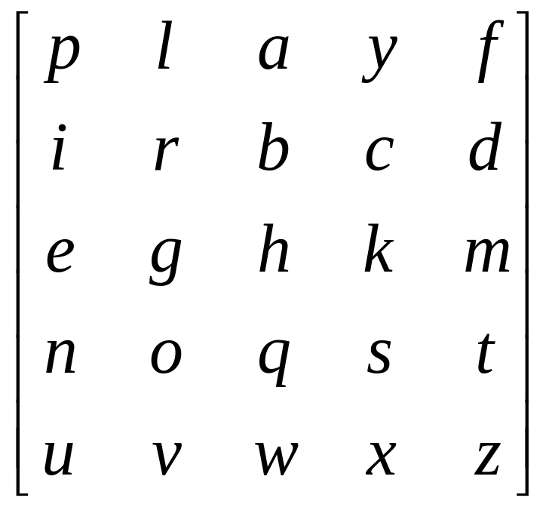
Playfair ciphers
In a 5x5 matrix, write the letters of the word “playfair” (for example) without dups, and fill in with other letters of the alphabet, except I,J used interchangeably.

Slide 75
Playfair encryption
Break plaintext into letter pairs
  If a pair would contain double letters, split with x
  Pad end with x
  Hello there becomes…
  he lx lo th er ex
For each pair,
  If they are in the same row, replace each with the letter to its right
    he → KG
  If they are in the same column, replace each with the letter below it
    lo → RV
  Otherwise, replace each with letter we’d get if we swapped their column indices
    lx →YV
He lx lo th er ex
KG YV RV QM GI KU
To decrypt, just reverse!

Slide 76
Playfair Key Matrix
a 5X5 matrix of letters based on a keyword
fill in letters of keyword (remove duplicates)
fill rest of matrix with other letters
eg. using the keyword MONARCHY
M | O | N | A | R
C | H | Y | B | D
E | F | G | I/J | K
L | P | Q | S | T
U | V | W | X | Z
Notes:
The best-known multiple-letter encryption cipher is the Playfair, which treats digrams in the plaintext as single units and translates these units into ciphertext digrams. The Playfair algorithm is based on the use of a 5x5 matrix of letters constructed using a keyword. The rules for filling in this 5x5 matrix are: L to R, top to bottom, first with keyword after duplicate letters have been removed, and then with the remain letters, with I/J used as a single letter. This example comes from Dorothy Sayer's book "Have His Carcase", in which Lord Peter Wimsey solves it, and describes the use of a probably word attack.

Slide 77
Playfair cipher: Example
GLOW WORM
S | T | A | N | D
E | R | C | H | B
K | F | G | I | L
M | O | P | Q | U
V | W | X | Y | Z
GL OW WO RM
IK WT TW EO

Slide 78
Example
Key word: playfair example
Encrypting the message "Hide the gold in the tree stump“
HI DE TH EG OL DI NT HE TR EX ES TU MP

Slide 79
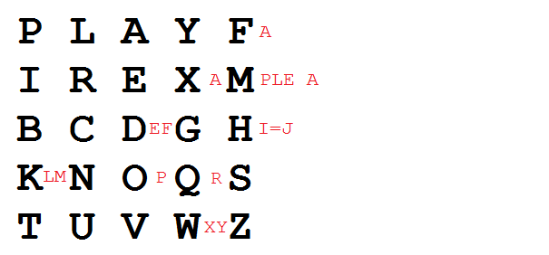

Slide 80
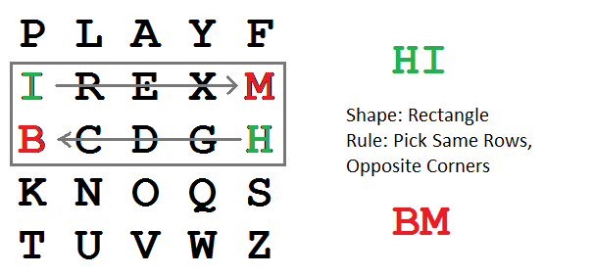
HI DE TH EG OL DI NT HE TR EX ES TU MP

Slide 81
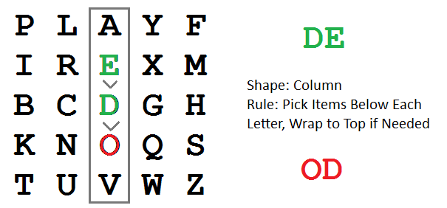
HI DE TH EG OL DI NT HE TR EX ES TU MP

Slide 82
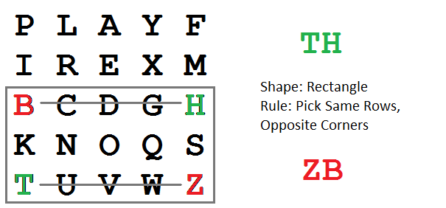
HI DE TH EG OL DI NT HE TR EX ES TU MP

Slide 83
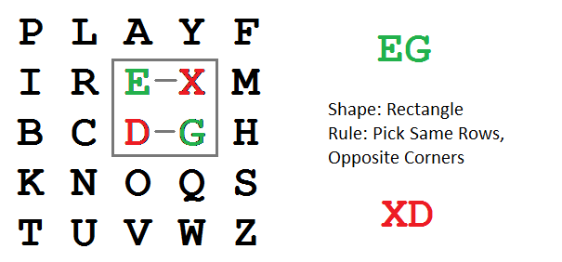
HI DE TH EG OL DI NT HE TR EX ES TU MP

Slide 84
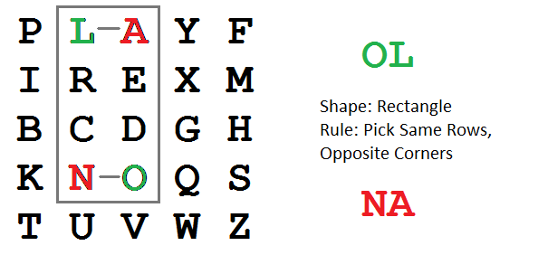
HI DE TH EG OL DI NT HE TR EX ES TU MP

Slide 85
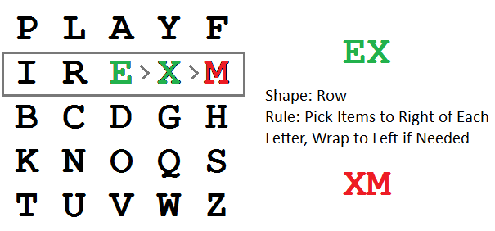
HI DE TH EG OL DI NT HE TR EX ES TU MP

Slide 86
HI DE TH EG OL DI NT HE TR EX ES TU MP
BM OD ZB XD NA BE KU DM UI XM MO UV IF

Slide 87
Encrypting and Decrypting
plaintext is encrypted two letters at a time
  if a pair is a repeated letter, insert filler like 'X’
  if both letters fall in the same row, replace each with letter to right (wrapping back to start from end)
  if both letters fall in the same column, replace each with the letter below it (again wrapping to top from bottom)
  otherwise each letter is replaced by the letter in the same row and in the column of the other letter of the pair
Notes:
Plaintext is encrypted two letters at a time,according to the rules as shown. Note how you wrap from right side back to left, or from bottom back to top.
if a pair is a repeated letter, insert a filler like 'X', eg. "balloon" encrypts as "ba lx lo on"
if both letters fall in the same row, replace each with letter to right (wrapping back to start from end), eg. “ar" encrypts as "RM"
if both letters fall in the same column, replace each with the letter below it (again wrapping to top from bottom), eg. “mu" encrypts to "CM"
otherwise each letter is replaced by the one in its row in the column of the other letter of the pair, eg. “hs" encrypts to "BP", and “ea" to "IM" or "JM" (as desired)
Decrypting of course works exactly in reverse. Can see this by working the example pairs shown, backwards.

Slide 88
Polyalphabetic Ciphers
polyalphabetic substitution ciphers
improve security using multiple cipher alphabets
make cryptanalysis harder with more alphabets to guess and flatter frequency distribution
use a key to select which alphabet is used for each letter of the message
use each alphabet in turn
repeat from start after end of key is reached
Notes:
One approach to reducing the "spikyness" of natural language text is used the Playfair cipher which encrypts more than one letter at once. We now consider the other alternative, using multiple cipher alphabets in turn. This gives the attacker more work, since many alphabets need to be guessed, and because the frequency distribution is more complex, since the same plaintext letter could be replaced by several ciphertext letters, depending on which alphabet is used. The general name for this approach is a polyalphabetic substitution cipher. All these techniques have the following features in common:
A set of related monoalphabetic substitution rules is used.
2. A key determines which particular rule is chosen for a given transformation.

Slide 89
Vigenère Cipher
simplest polyalphabetic substitution cipher
effectively multiple caesar ciphers
key is multiple letters long K = k₁ k₂ ... k_{d}
i^{th} letter specifies i^{th} alphabet to use
use each alphabet in turn
repeat from start after d letters in message
decryption simply works in reverse
Notes:
The best known, and one of the simplest, such algorithms is referred to as the Vigenère cipher, where the set of related monoalphabetic substitution rules consists of the 26 Caesar ciphers, with shifts of 0 through 25. Each cipher is denoted by a key letter, which is the ciphertext letter that substitutes for the plaintext letter ‘a’, and which are each used in turn, as shown next.

Slide 90
Example of plyalphabetic substitution
write the plaintext out
write the keyword repeated above it
use each key letter as a caesar cipher key
encrypt the corresponding plaintext letter
eg using keyword deceptive
  key: de cep tivedecept ived eceptive
  plaintext: we are discovered save yourself
  ciphertext:ZI CVT WQNGRZGVTW AVZH CQYGLMGJ
Notes:
Discuss this simple example from text Stallings section 2.2.

Slide 91
Polyalphabetic Cipher
The most common method used is Vigenère cipher
Vigenère cipher starts with a 26 x 26 matrix of alphabets in sequence. First row starts with ‘A’, second row starts with ‘B’, etc.
Like the ADFGVX cipher, this cipher also requires a keyword that the sender and receiver know ahead of time
Each character of the message is combined with the characters of the keyword to find the ciphertext character

Slide 92
Vigenère Cipher Table
A B C D E F G H I J K L M N O P Q R S T U V W X Y Z
A A B C D E F G H I J K L M N O P Q R S T U V W X Y Z
B B C D E F G H I J K L M N O P Q R S T U V W X Y Z A
C C D E F G H I J K L M N O P Q R S T U V W X Y Z A B
D D E F G H I J K L M N O P Q R S T U V W X Y Z A B C
E E F G H I J K L M N O P Q R S T U V W X Y Z A B C D
F F G H I J K L M N O P Q R S T U V W X Y Z A B C D E
G G H I J K L M N O P Q R S T U V W X Y Z A B C D E F
H H I J K L M N O P Q R S T U V W X Y Z A B C D E F G
I I J K L M N O P Q R S T U V W X Y Z A B C D E F G H
J J K L M N O P Q R S T U V W X Y Z A B C D E F G H I
K K L M N O P Q R S T U V W X Y Z A B C D E F G H I J
L L M N O P Q R S T U V W X Y Z A B C D E F G H I J K
M M N O P Q R S T U V W X Y Z A B C D E F G H I J K L

Slide 93
Vigenère Cipher Table (cont’d)
A B C D E F G H I J K L M N O P Q R S T U V W X Y Z
N N O P Q R S T U V W X Y Z A B C D E F G H I J K L M
O O P Q R S T U V W X Y Z A B C D E F G H I J K L M N
P P Q R S T U V W X Y Z A B C D E F G H I J K L M N O
Q Q R S T U V W X Y Z A B C D E F G H I J K L M N O P
R R S T U V W X Y Z A B C D E F G H I J K L M N O P Q
S S T U V W X Y Z A B C D E F G H I J K L M N O P Q R
T T U V W X Y Z A B C D E F G H I J K L M N O P Q R S
U U V W X Y Z A B C D E F G H I J K L M N O P Q R S T
V V W X Y Z A B C D E F G H I J K L M N O P Q R S T U
W W X Y Z A B C D E F G H I J K L M N O P Q R S T U V
X X Y Z A B C D E F G H I J K L M N O P Q R S T U V W
Y Y Z A B C D E F G H I J K L M N O P Q R S T U V W X
Z Z A B C D E F G H I J K L M N O P Q R S T U V W X Y

Slide 94
Polyalphabetic Cipher
E.g., Message = SEE ME IN MALL
Take keyword as INFOSEC
Vigenère cipher works as follows:
S E E M E I N M A L L
I N F O S E C I N F O
-------------------------------------
A R J A W M P U N Q Z

Slide 95
Polyalphabetic Cipher
E.g., Message = SEE ME IN MALL
Take keyword as INFOSEC
Vigenère cipher works as follows:
S E E M E I N M A L L
I N F O S E C I N F O
-------------------------------------
A R J A W M P U N Q Z

Slide 96
Vigenère Cipher Table
A B C D E F G H I J K L M N O P Q R S T U V W X Y Z
A A B C D E F G H I J K L M N O P Q R S T U V W X Y Z
B B A B C D E F G H I J K L M N O P Q R S T U V W X Y
C C D E F G H I J K L M N O P Q R S T U V W X Y Z A B
D D E F G H I J K L M N O P Q R S T U V W X Y Z A B C
E E F G H I J K L M N O P Q R S T UV W X Y Z A B C D
F F G H I J K L M N O P Q R S T U VW X Y Z A B C D E
G G H I J K L M N O P Q R S T U V WX Y Z A B C D E F
H H I J K L M N O P Q R S T U V W XY Z A B C D E F G
I I J K L M N O P Q R S T U V W X YZ A B C D E F G H
J J K L M N O P Q R S T U V W X Y ZAB C D E F G H I
K K L M N O P Q R S T U V W X Y Z A B C D E F G H I J
L L M N O P Q R S T U V W X Y Z A B C D E F G H I J K
M M N O P Q R S T U V W X Y Z A B C D E F G H I J K L

Slide 97
Polyalphabetic Cipher
E.g., Message = SEE ME IN MALL
Take keyword as INFOSEC
Vigenère cipher works as follows:
S E E M E I N M A L L
I N F O S E C I N F O
-------------------------------------
A R J A W M P U N Q Z

Slide 98
Vigenère Cipher Table (cont’d)
A B C D E F G H I J K L M N O P Q R S T U V W X Y Z
N N O P Q R S T U V W X Y Z A B C D E F G H I J K L M
O O P Q R S T U V W X Y Z A B C D E F G H I J K L M N
P P Q R S T U V W X Y Z A B C D E F G H I J K L M N O
Q Q R S T U V W X Y Z A B C D E F G H I J K L M N O P
R R S T U V W X Y Z A B C D E F G H I J K L M N O P Q
S S T U V W X Y Z A B C D E F G H I J K L M N O P Q R
T T U V W X Y Z A B C D E F G H I J K L M N O P Q R S
U U V W X Y Z A B C D E F G H I J K L M N O P Q R S T
V V W X Y Z A B C D E F G H I J K L M N O P Q R S T U
W W X Y Z A B C D E F G H I J K L M N O P Q R S T U V
X X Y Z A B C D E F G H I J K L M N O P Q R S T U V W
Y Y Z A B C D E F G H I J K L M N O P Q R S T U V W X
Z Z A B C D E F G H I J K L M N O P Q R S T U V W X Y

Slide 99
Polyalphabetic Cipher
E.g., Message = SEE ME IN MALL
Take keyword as INFOSEC
Vigenère cipher works as follows:
S E E M E I N M A L L
I N F O S E C I N F O
-------------------------------------
A R J A W M P U N Q Z

Slide 100
Vigenère Cipher Table
A B C D E F G H I J K L M N O P Q R S T U V W X Y Z
A A B C D E F G H I J K L M N O P Q R S T U V W X Y Z
B B A B C D E F G H I J K L M N O P Q R S T U V W X Y
C C D E F G H I J K L M N O P Q R S T U V W X Y Z A B
D D E F G H I J K L M N O P Q R S T U V W X Y Z A B C
E E F G H I J K L M N O P Q R S T UV W X Y Z A B C D
F F G H I J K L M N O P Q R S T U V W XYZ A B C D E
G G H I J K L M N O P Q R S T U V W X Y Z AB C D E F
H H I J K L M N O P Q R S T U V W XY Z A B C D E F G
I I J K LM N O P Q R S T U V W X YZ A B C D E F G H
J J K L M N O P Q R S T U V W X Y ZAB C D E F G H I
K K L M N O P Q R S T U V W X Y Z A B C D E F G H I J
L L M N O P Q R S T U V W X Y Z A B C D E F G H I J K
M M N O P Q R S T U V W X Y Z A B C D E F G H I J K L

Slide 101
Polyalphabetic Cipher
To decrypt, the receiver places the keyword characters below each ciphertext character
Using the table, choose the row corresponding to the keyword character and look for the ciphertext character in that row
Plaintext character is then at the top of that column

Slide 102
Polyalphabetic Cipher
Decryption of ciphertext:
A R J A W M P U N Q Z
I N F O S E C I N F O
-------------------------------------
S E E M E I N M A L L
Best feature is that same plaintext character is substituted by different ciphertext characters (i.e., polyalphabetic)

Slide 103
Vigenère Cipher Table
A B C D E F G H I J K L M N O P Q R S T U V W X Y Z
A A B C D E F G H I J K L M N O P Q R S T U V W X Y Z
B B C D E F G H I J K L M N O P Q R S T U V W X Y Z A
C C D E F G H I J K L M N O P Q R S T U V W X Y Z A B
D D E F G H I J K L M N O P Q R S T U V W X Y Z A B C
E E F G H I J K L M N O P Q R S T U V W X Y Z A B C D
F F G H I J K L M N O P Q R S T U V W X Y Z A B C D E
G G H I J K L M N O P Q R S T U V W X Y Z A B C D E F
H H I J K L M N O P Q R S T U V W X Y Z A B C D E F G
I I J K L M N O P Q R S T U V W X Y Z A B C D E F G H
J J K L M N O P Q R S T U V W X Y Z A B C D E F G H I
K K L M N O P Q R S T U V W X Y Z A B C D E F G H I J
L L M N O P Q R S T U V W X Y Z A B C D E F G H I J K
M M N O P Q R S T U V W X Y Z A B C D E F G H I J K L

Slide 104
Polyalphabetic Cipher
Decryption of ciphertext:
A R J A W M P U N Q Z
I N F O S E C I N F O
-------------------------------------
S E E M E I N M A L L
Best feature is that same plaintext character is substituted by different ciphertext characters (i.e., polyalphabetic)

Slide 105
Vigenère Cipher Table (cont’d)
A B C D E F G H I J K L M N O P Q R S T U V W X Y Z
N N O P Q R S T U V W X Y Z A B C D E F G H I J K L M
O O P Q R S T U V W X Y Z A B C D E F G H I J K L M N
P P Q R S T U V W X Y Z A B C D E F G H I J K L M N O
Q Q R S T U V W X Y Z A B C D E F G H I J K L M N O P
R R S T U V W X Y Z A B C D E F G H I J K L M N O P Q
S S T U V W X Y Z A B C D E F G H I J K L M N O P Q R
T T U V W X Y Z A B C D E F G H I J K L M N O P Q R S
U U V W X Y Z A B C D E F G H I J K L M N O P Q R S T
V V W X Y Z A B C D E F G H I J K L M N O P Q R S T U
W W X Y Z A B C D E F G H I J K L M N O P Q R S T U V
X X Y Z A B C D E F G H I J K L M N O P Q R S T U V W
Y Y Z A B C D E F G H I J K L M N O P Q R S T U V W X
Z Z A B C D E F G H I J K L M N O P Q R S T U V W X Y

Slide 106
Polyalphabetic Cipher
Decryption of ciphertext:
A R J A W M P U N Q Z
I N F O S E C I N F O
-------------------------------------
S E E M E I N M A L L
Best feature is that same plaintext character is substituted by different ciphertext characters (i.e., polyalphabetic)

Slide 107
Vigenère Cipher Table
A B CD E F G H I J K L M N O P Q R S T U V W X Y Z
A A B C D E F G H I J K L M N O P Q R S T U V W X Y Z
B B C D E F G H I J K L M N O P Q R S T U V W X Y Z A
C C D E F G H I J K L M N O P Q R S T U V W X Y Z A B
D D E F G H I J K L M N O P Q R S T U V W X Y Z A B C
E E F G H I J K L M N O P Q R S T U V W X Y Z A B C D
F F G H I J K L M N O P Q R S T U V W X Y Z A B C D E
G G H I J K L M N O P Q R S T U V W X Y Z A B C D E F
H H I J K L M N O P Q R S T U V W X Y Z A B C D E F G
I I J K L M N O P Q R S T U V W X Y Z A B C D E F G H
J J K L M N O P Q R S T U V W X Y Z A B C D E F G H I
K K L M N O P Q R S T U V W X Y Z A B C D E F G H I J
L L M N O P Q R S T U V W X Y Z A B C D E F G H I J K
M M N O P Q R S T U V W X Y Z A B C D E F G H I J K L

Slide 108
Transposition Ciphers
now consider classical transposition or permutation ciphers
these hide the message by rearranging the letter order
without altering the actual letters used
Notes:
All the techniques examined so far involve the substitution of a ciphertext symbol for a plaintext symbol. A very different kind of mapping is achieved by performing some sort of permutation on the plaintext letters. This technique is referred to as a transposition cipher, and form the second basic building block of ciphers. The core idea is to rearrange the order of basic units (letters/bytes/bits) without altering their actual values.

Slide 109

Transposition ciphers
A transposition cipher does not substitute one symbol for another, instead it changes the location of the symbols.
Note
Keyless Transposition Ciphers
Keyed Transposition Ciphers
Combining Two Approaches

Slide 110
Keyless Transposition Ciphers
Simple transposition ciphers, which were used in the past, are keyless.
A good example of a keyless cipher using the first method is the rail fence cipher. The ciphertext is created reading the pattern row by row. For example, to send the message “Meet me at the park” to Bob, Alice writes
She then creates the ciphertext “MEMATEAKETETHPR”.

Slide 111
Rail Fence cipher
write message letters out diagonally over a number of rows
then read off cipher row by row
Eg: meet me after the party
write message out as:
  m e m a t r h p r y
  e t e f e t e a t
giving ciphertext
  MEMATRHPRYETEFETEAT
Notes:
The simplest such cipher is the rail fence technique, in which the plaintext is written down as a sequence of diagonals and then read off as a sequence of rows.
The example message is: "meet me after the toga party" with a rail fence of depth 2.
This sort of thing would be trivial to cryptanalyze.

Slide 112
Keyless Transposition Ciphers
Rearrangement of the letters or a message
Columnar transposition
    Plaintext Ciphertext
    W H Y D O welrnel
    E S I T A hswatta
    L W A Y S yiaihhn
    R A I N I dtyneed
    N T H E N oasinrs
    E T H E R
    L A N D S

Slide 113
Keyless Transposition Ciphers
Alice and Bob can agree on the number of columns and use the second method. Alice writes the same plaintext, row by row, in a table of four columns.
M | E | E | T
M | E | A | T
T | H | E | P
A | R | K
She then creates the ciphertext “MMTAEEHREAEKTTP”.

Slide 114
Keyed Transposition Ciphers
The keyless ciphers permute the characters by using writing plaintext in one way and reading it in another way.
The permutation is done on the whole plaintext to create the whole ciphertext.
Another method is to divide the plaintext into groups of predetermined size, called blocks, and then use a key to permute the characters in each block separately.

Slide 115
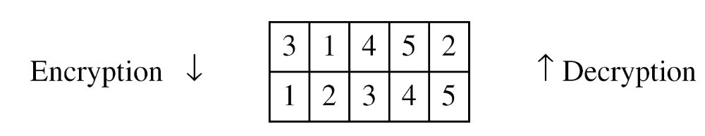
Keyed Transposition Ciphers-row transposition
Alice needs to send the message “Enemy attacks tonight” to Bob..
The key used for encryption and decryption is a permutation key, which shows how the character are permuted.
The permutation yields

Slide 116
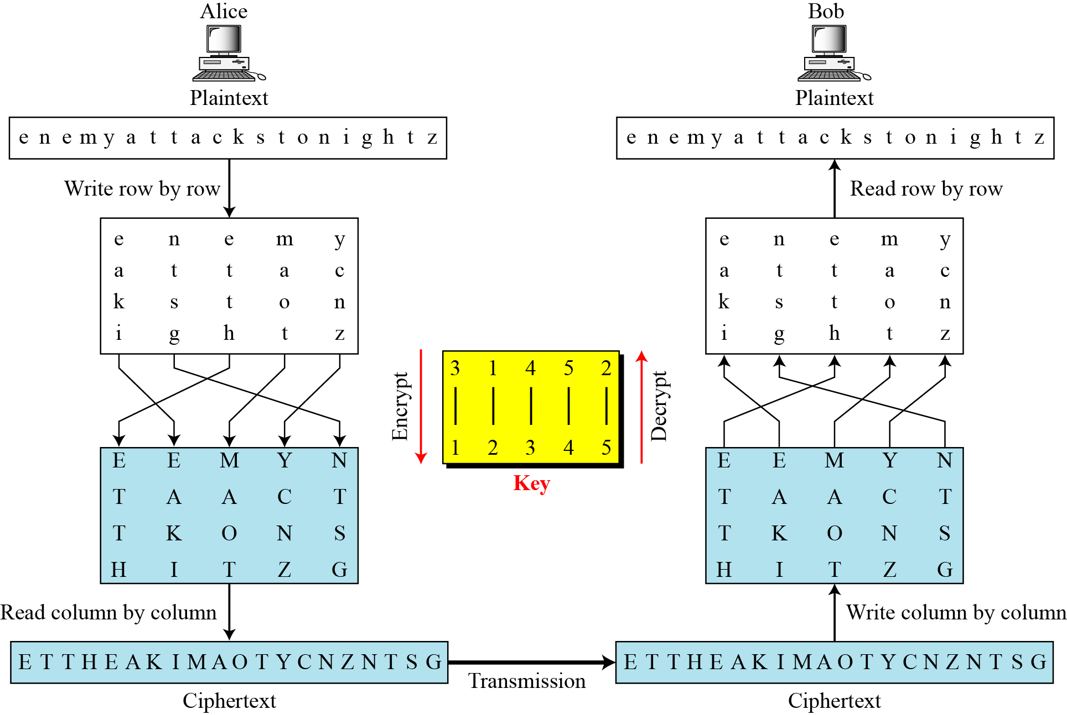

Slide 117
Example
Write letters of message out in rows over a specified number of columns
Then reorder the columns according to some key before reading off the columns
Example: attack postponed until two am
  Key: 3 4 2 1 5 6 7
  Plaintext: a t t a c k p
  o s t p o n e
  d u n t i l t
  w o a m x y z
  Ciphertext: APTMTTNAAODWTSUOCOIXKNLYPETZ

Slide 118
Cipher Classification
Ciphers
Public Key
Symmetric
Key
PublicKey
Signature
ID
Classical
Stream
Block
Transposition
Substitution

Slide 119
Types of Ciphers
symmetric ciphers can be broadly classified into the following two categories depending upon whether
    a symbol of plaintext is immediately converted into a symbol of ciphertext (Stream Ciphers)
    a group of plaintext symbols are converted as a block into a group of ciphertext symbols (Block Ciphers)

Slide 120
Stream Ciphers
A symbol of plaintext is immediately converted into a symbol of ciphertext(bit-by-bit)
Advantages
  Speed of transformation-each symbol is encrypted without regard for any other plaintext symbol
  Low error propagation-cos each symbol is separately encoded, an error affets only that character
Disadvantages
  Low diffusion-each symbol is separately enciphered. So all info of that symbol is contained in one symbol of the ciphertext
  Susceptible to skipping of characters which affect all other characters

Slide 121
Examples
monoalphabetic substitution ciphers
Vigenere ciphers

Slide 122
Block Ciphers
Group of plaintext symbols are converted as a block into a group of ciphertext symbols(block by block)
Advantages
  High Diffusion-info from plaintext is diffused into several ciphertext symbols. One cipher block depend on several plaintext
  Immunity to insertions
Disadvantages
  Slowness of encryption
  require more memory, since they work on larger chunks of data
  Error propagation-error affects all other characters in the block

Slide 123
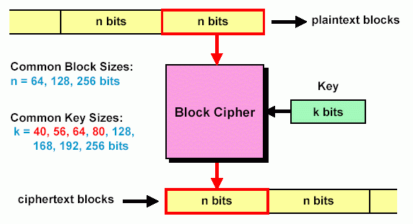
Block Cipher
Divide input bit stream into n-bit sections, encrypt only that section
In a good block cipher, each output bit is a function of all n input bits and all k key bits

